Slide 1
Adaptabrawl — Fall Design Presentation (Assignment #8)
Project Purposes & Goals | CS5001 — Senior Design (Fall 2025)

Slide 2
Team & Contacts
Faculty/Industry Advisor: Vikas Rishishwar
Repository: Adaptabrawl-Senior-Design
Name | Role | Email
Kartavya Singh | Netcode & Infrastructure | singhk6@mail.uc.edu
Saarthak Sinha | Combat/Systems | sinhas6@mail.uc.edu
Kanav Shetty | UX/UI & Content | shettykv@mail.uc.edu
Yash Ballabh | Tools, CI/CD & QA | ballabyh@mail.uc.edu

Slide 3
Project Abstract
Adaptabrawl is a 2D multiplayer fighting game that blends attack, defense, and evasion into a fast, legible combat loop. Matches evolve through adaptive conditions—stage/weather/match modifiers—and clear status effects such as poison, stagger/heavy‑attack windup, and low‑HP state. The experience prioritizes readability (icons, timers, telegraphs) and fairness. Technically, we target Unity LTS with a host‑authoritative online model, client prediction with server reconciliation, snapshot sync, and lag‑compensated hit validation. Semester‑1 aims for a vertical slice: two fighters, one stage, and stable online 1v1 with join‑by‑code lobbies. The result is a transparent, adaptive fighter where players can fluidly switch styles without losing clarity or balance.

Slide 4
User Stories
As an online competitor, I want reliable 1v1 lobbies with predictable latency and easy rematch/reconnect.
As a player on mid‑spec hardware, I want scalable VFX/performance presets to maintain frame rate.
As a character explorer, I want fighters with clear playstyles and difficulty tags for quick selection.
As a local 1v1 player, I want offline versus so we can play without internet or setup delays.
As a character developer, I want a documented character template to add or adjust fighters quickly.
As a friend‑match player, I want shareable room‑code invites so we can play immediately without accounts.

Slide 5
Design Diagrams : L1–L3 Overview
Level 1 — System I/O: Inputs (Player Controls, Settings, Match Context, Network In, Clock); Outputs (Visuals, Audio, Haptics, Network Out, Telemetry/Replays/Logs).
Level 2 — Subsystems & Flow: Input Layer, Settings/Accessibility, Match Config, Networking, Clock → Game State/Rules ↔ Physics/Collision ↔ Net Sync/Authority → UI/HUD → Rendering/Audio; Event Bus decouples producers/consumers.
Level 3 — Concrete Components: Input adapters/buffering, Rules Engine FSM (hits/hurt/status/round flow), Content DB (fighters/moves/stages/ status), deterministic timing, Transport/Session/ Sync with prediction & correction, replays/telemetry, creator pipeline for new fighters.

Slide 6
Major Project Constraints
Economic: Unity LTS + free/low‑cost tooling; vertical slice scope to keep costs near zero.
Network: Use Unity Relay/Lobby; bandwidth‑thrifty sync (20–30 Hz), simple prediction, join‑by‑code sessions.
Legal: Only original/permissive‑licensed assets (MIT/CC‑BY/etc.); track provenance; avoid third‑party IP.
Privacy/Security: Host‑authoritative hits; encrypt transport where supported; rate‑limit lobbies; minimal logs.
Accessibility & Inclusion: Color‑safe palettes; scalable text; controller/keyboard parity; full remapping.
Fairness & Disclosure: Adaptive modifiers are transparent and clearly surfaced in HUD/UI.

Slide 7
Project Progress — Current State
Completed: Professional Biography, Team Contract (signed), Design Diagrams, Tasklist, Milestone, Timeline, and Effort Matrix, Project Constraints.
Engine: Unity LTS v3.15.1 (Editor 6000.2.6f2), Mirror Framework, C#.
Repo & docs created; architecture and semester plan defined and currently in progress.
In progress: Core combat prototype (offline) and status/condition system v1; UI/HUD scaffolding; lobby flow draft.

Slide 8
Expected Accomplishments (End of Fall Term)
Core offline combat: movement, light/heavy, block/parry, dodge; status effects v1; adaptive conditions v1.
Online baseline: host‑authoritative 1v1, client prediction + reconciliation, room‑code lobbies via Relay/Lobby.
Usability: controller/keyboard input maps with rebinds; readable HUD with status icons/timers.
S1 Vertical Slice build (target mid‑December): two fighters, one stage, stable online play.

Slide 9
Division of Work
Kartavya Singh
Netcode & Infrastructure: authority model, prediction/reconciliation, Relay/Lobby, stress tests, CI setup.
Saarthak Sinha
Combat/Systems: FSM (startup/active/recovery), hit/hurt/damage, two starter fighters, status/conditions v1, frame data tuning.
Kanav Shetty
UX/UI & Content: HUD (HP, status timers), lobby/post‑match flows, input maps & rebind UI, readable VFX/SFX, accessibility tests.
Yash Ballabh
Tools, CI/CD & QA: Win64 CI builds, telemetry/exporter, training mode & hitbox viewer, perf profiling & budgets, docs & packaging.

Slide 10

Expected Demo at Expo
Live 1v1 match on the vertical slice (two fighters, one stage) with readable HUD and status icons.
Join‑by‑code lobby flow, quick rematch, and a visible netgraph (RTT/jitter/loss) for transparency.
Showcase of adaptive conditions and status effects with clear on‑screen disclosure.
Short gameplay clip + repo link and documentation for faculty review.

Slide 11
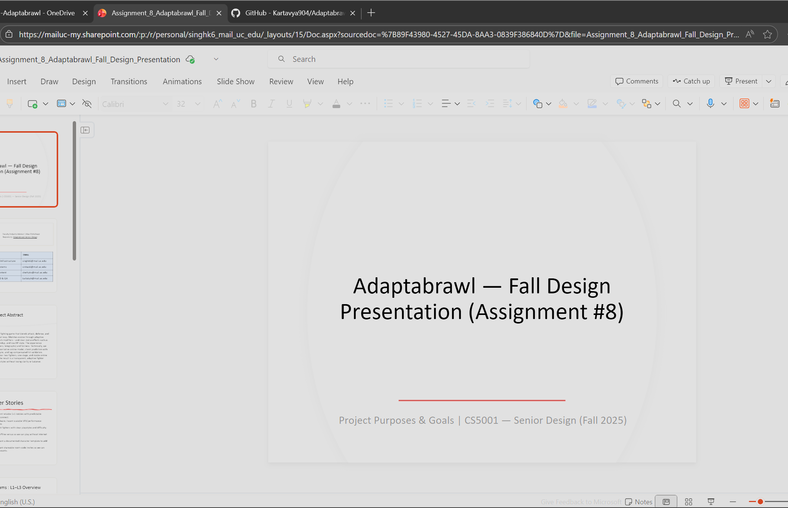
Presentation Demo

